Slide 1



Design of Boost PFC Converter
Course Project
Course: Power Converters for EV Chargers
Guide: Prof. Siddavatam Ravi Prakash Reddy
Department of Energy Science and Engineering
Indian Institute of Technology Bombay

Slide 2

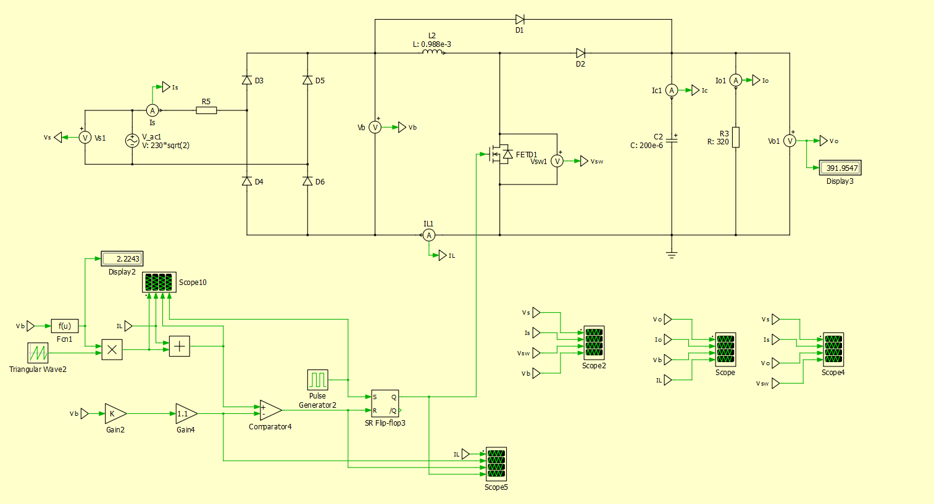
Unidirectional front-end converter: Boost PFC
Major appliance equipment such as air conditioners, refrigerators, and washers use three-phase, pulse-width modulated BLDC or PMSM drives. These drives require a front-end power PFC regulator to shape the input current of the power supply and to meet the standards for power factor and current THD, such as IEC 61000-3-2.
A PFC circuit shapes the input current of the power supply to be in phase with the mains voltage and helps to maximize the real power drawn from the mains.
Front-end PFC also offers several benefits:
Reduces RMS input current
Facilitates power supply hold-up
Improves efficiency of downstream converters

Slide 3
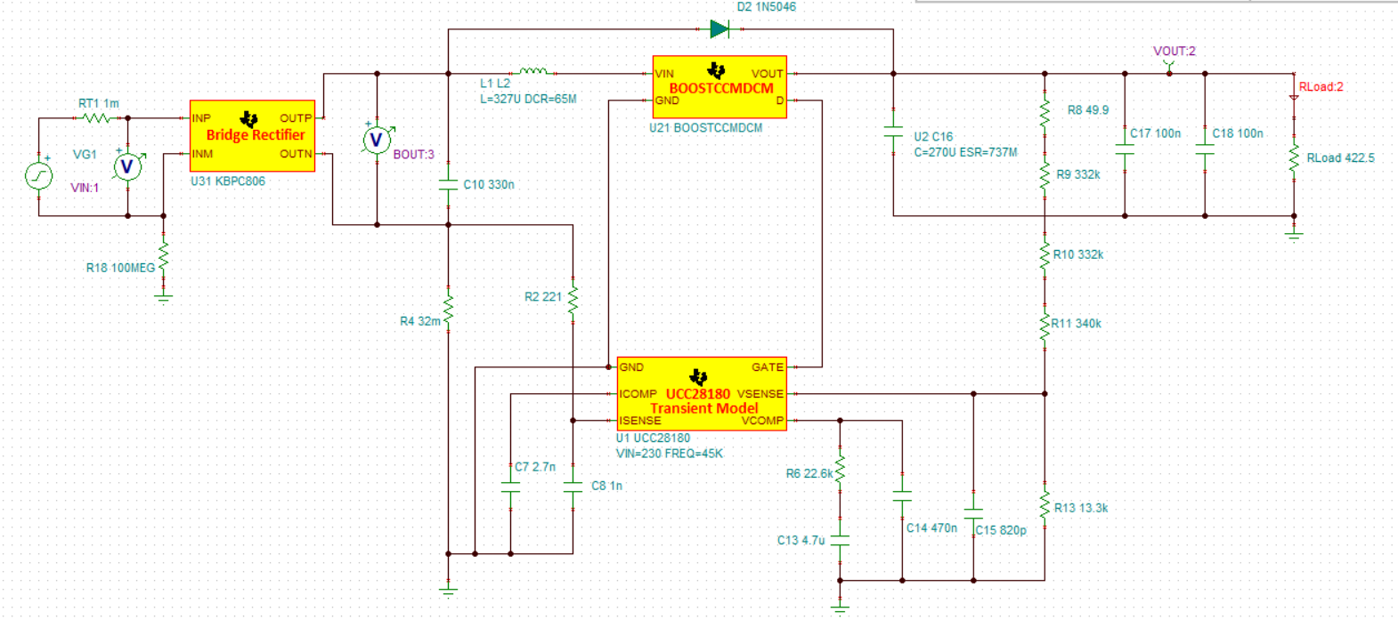
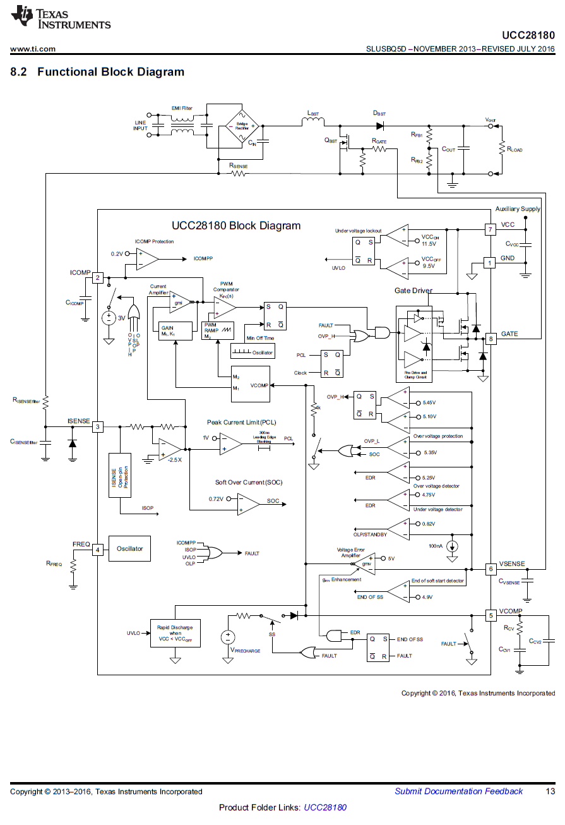
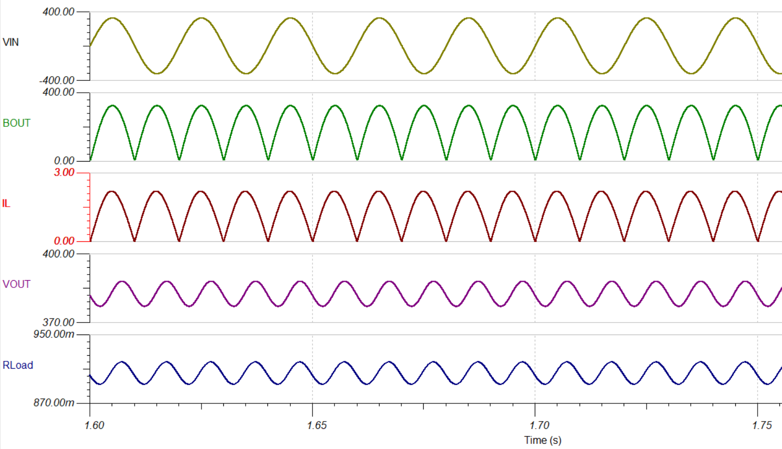
Boost PFC: TINA simulation

Slide 4
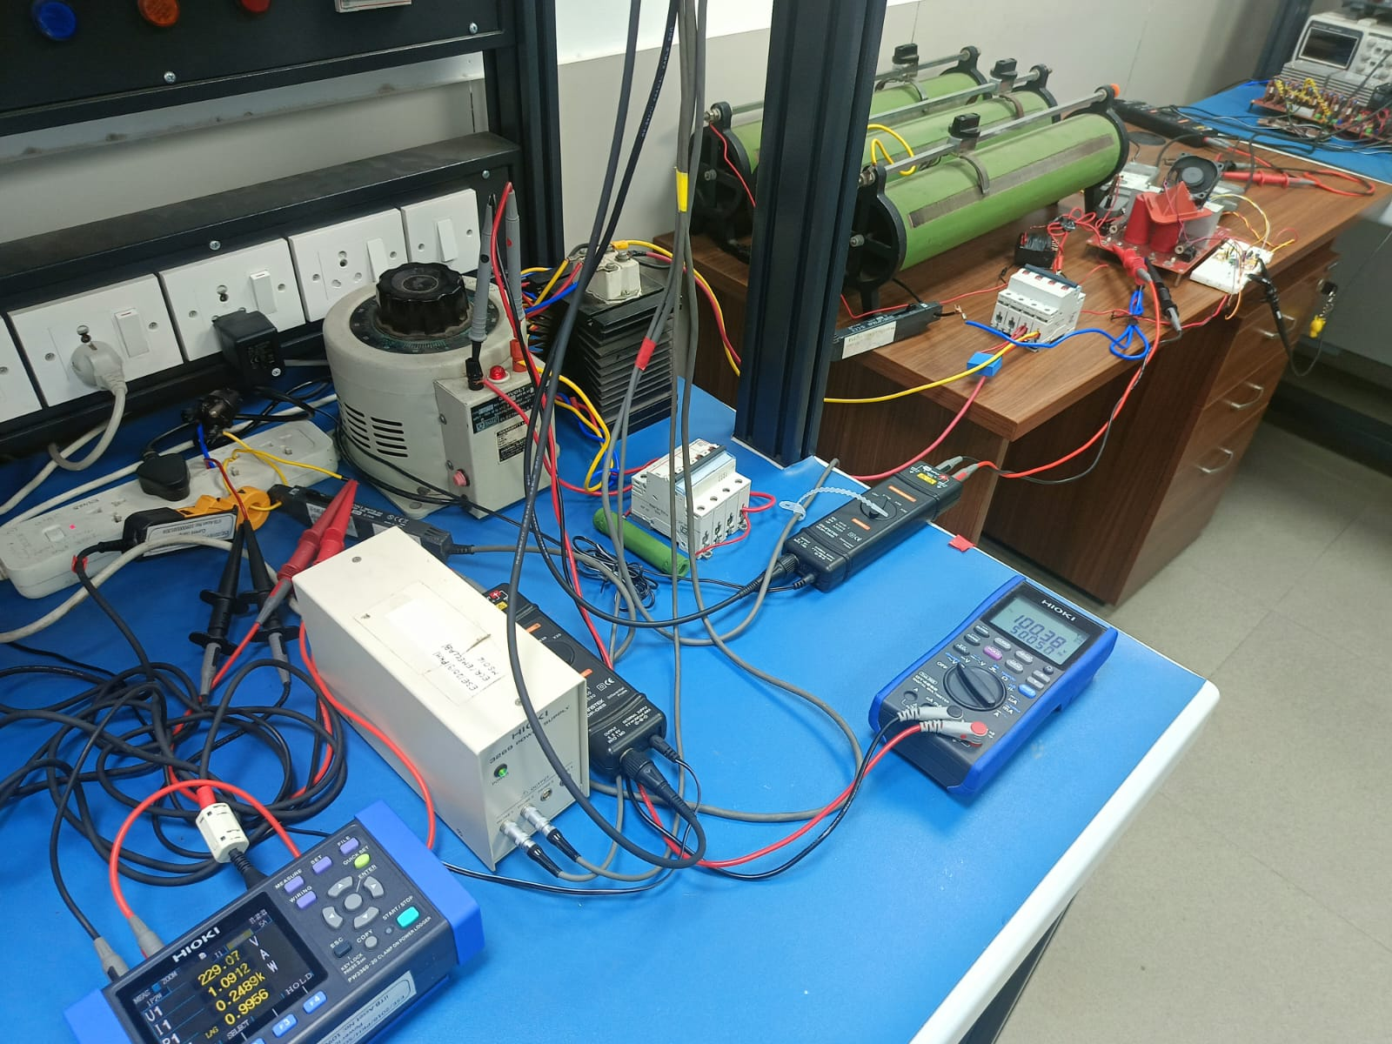
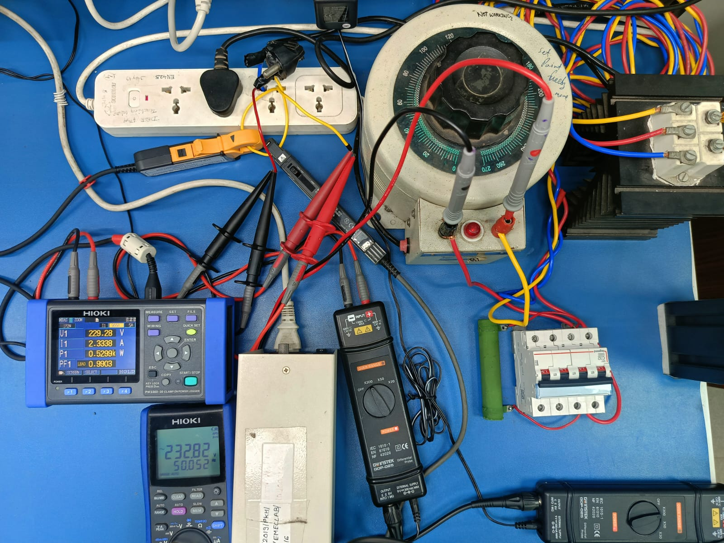
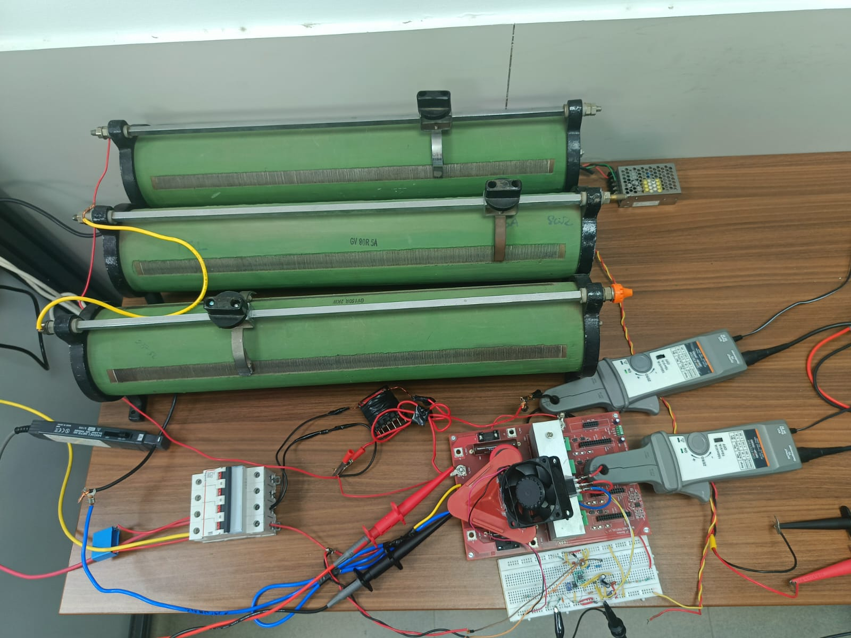
Boost PFC Hardware setup
Load
15V power supply for controller
Supply
Rectifier
Auto- Transformer
Power Analyser
Switches
Series resistance to limit Inrush Current
Inductor
Shunt Resistance for current measurement
UCC28180 Controller

Slide 5
Boost PFC operating parameters
Input Voltage (AC) | 230V
Output Voltage (DC) | 400V
Inductor (L) | 2mH
Controller IC | TI: UCC28180
Switches | D1= 1N5406: 600V, 3A D2: U1560: 15A 600V Sw: K40H1203: 1200V, 40A
Output Capacitor | 820uF, 450V
Frequency of operation | 45kHz
Shunt Resistance for current measurement | 10mΩ

Slide 6
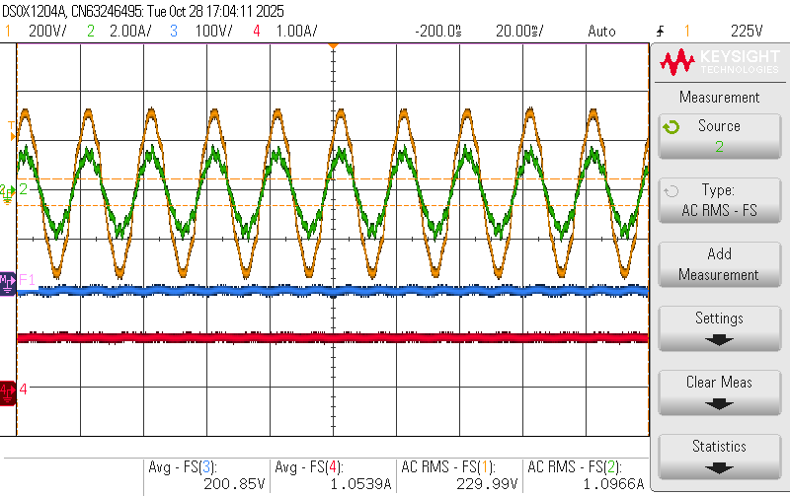
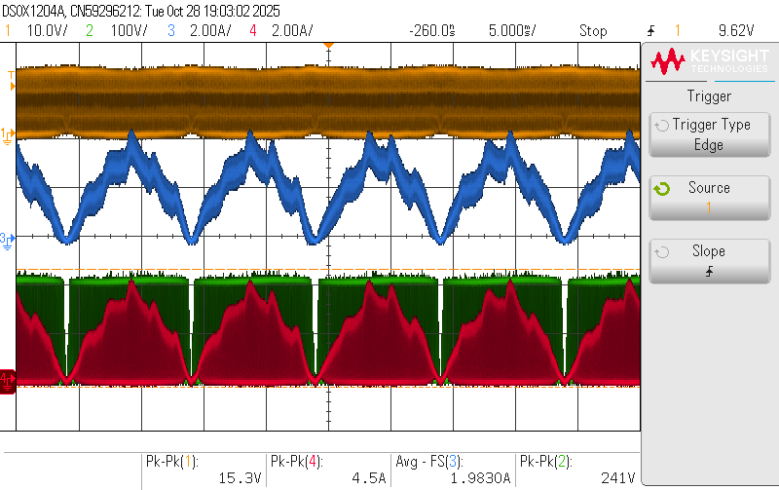
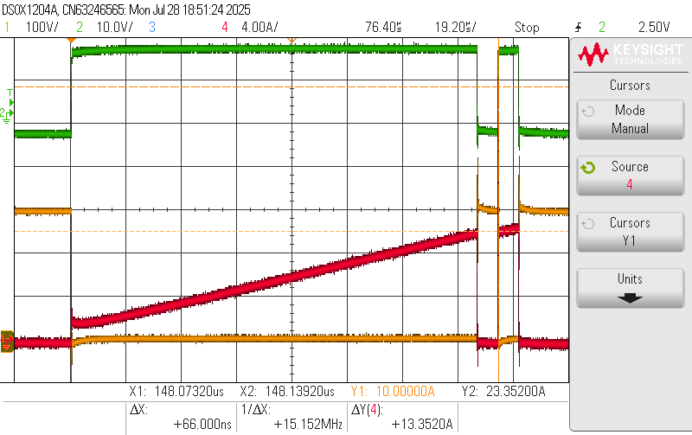
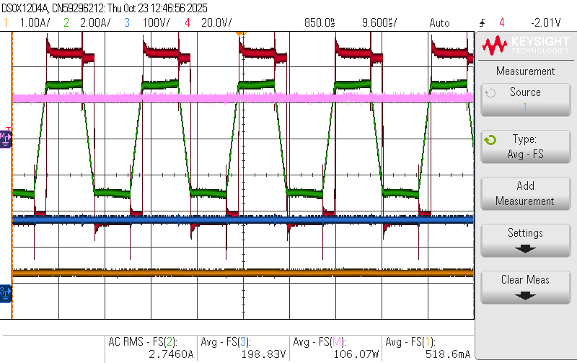
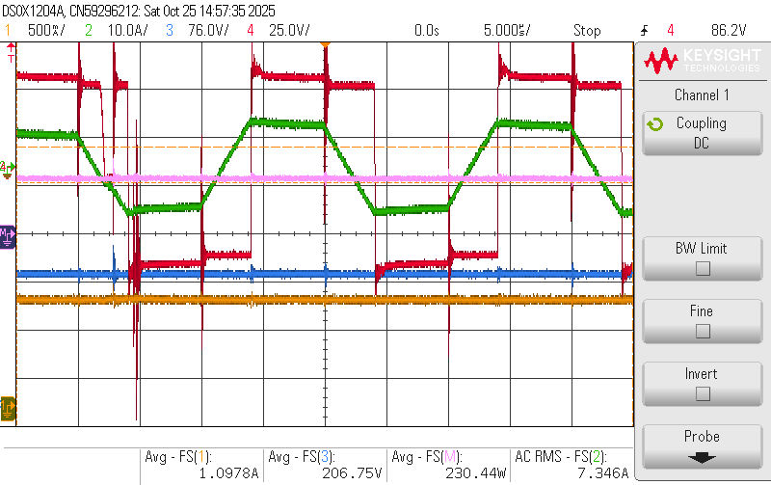
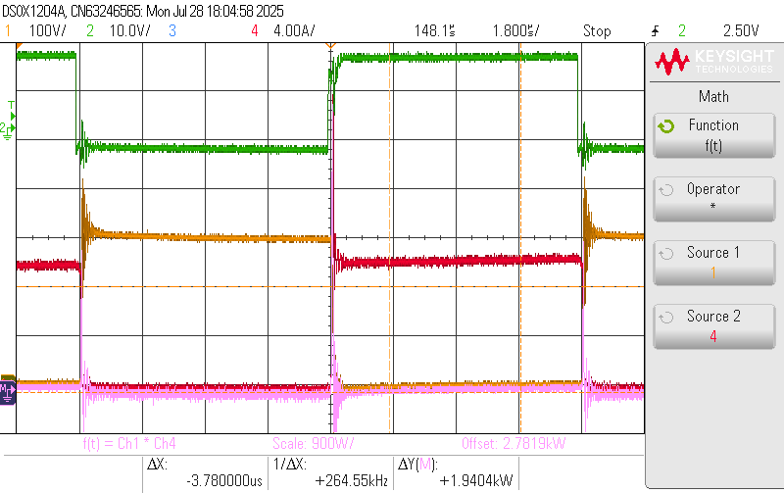
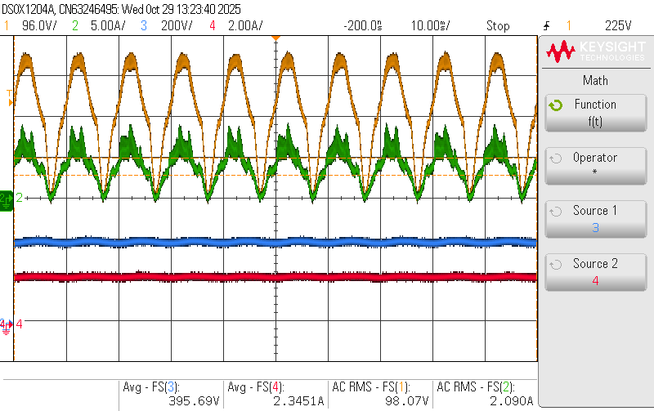
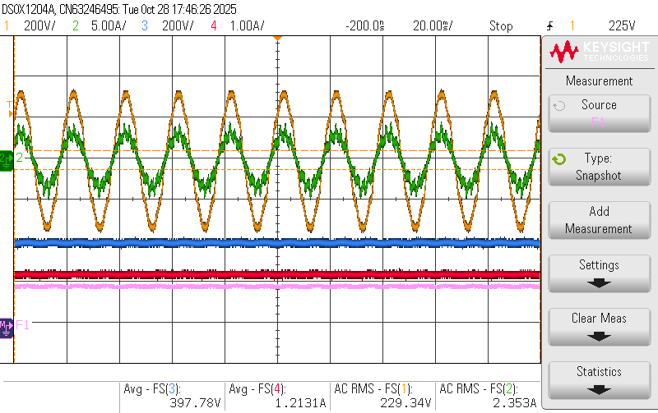
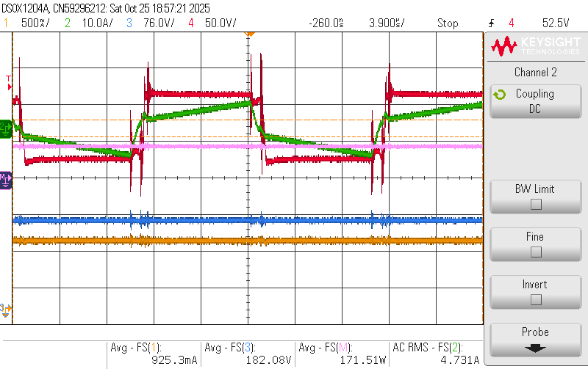
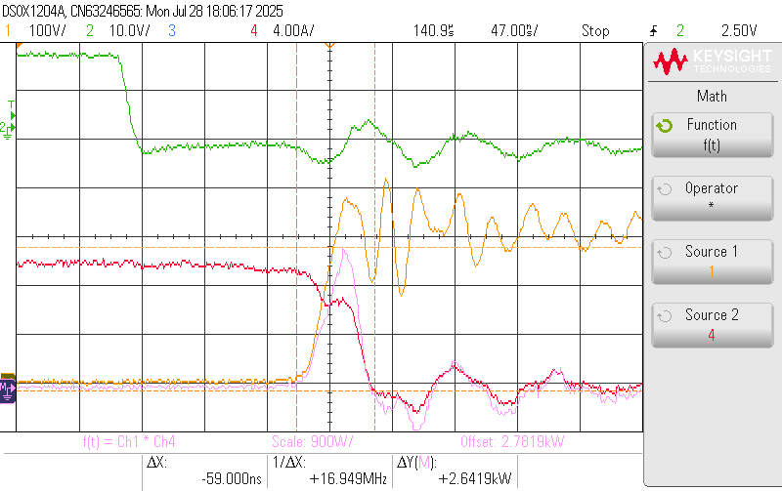
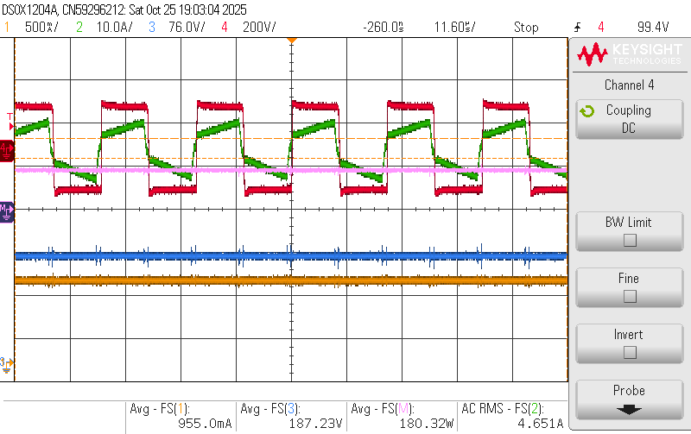
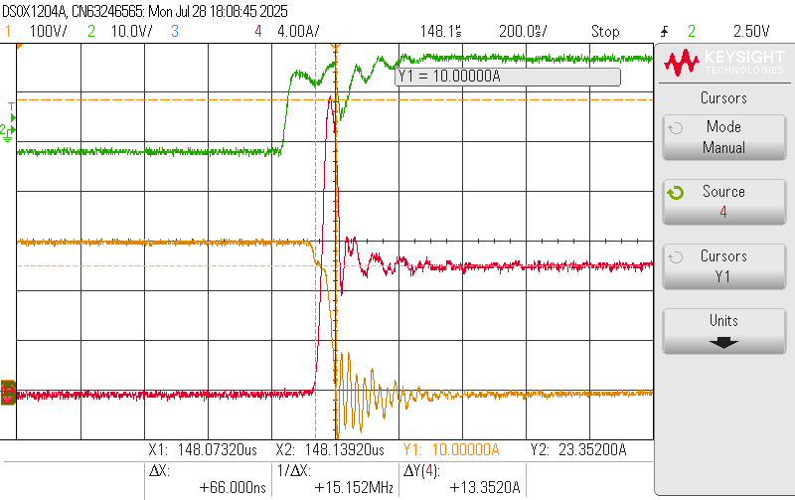
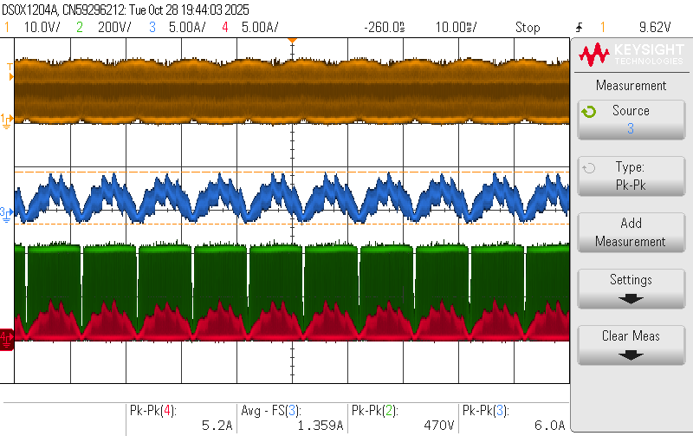
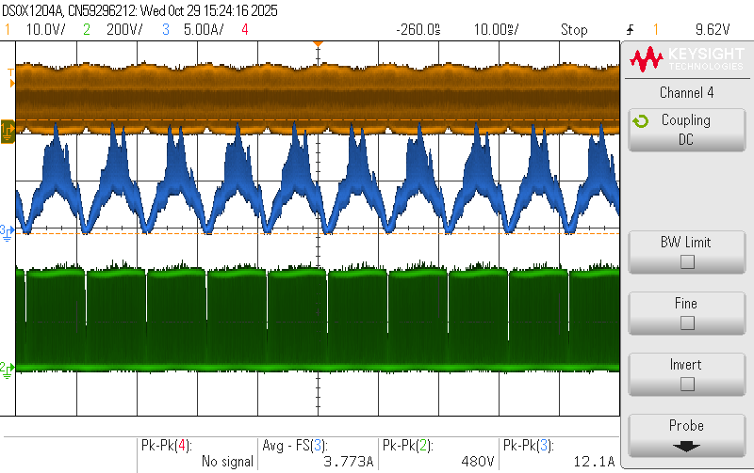
Boost PFC experimental results
Vin = 100V AC
Vout = 200V DC
Pin = 252W
Pout = 211.49W
𝞰 = 83.926%
PF = 0.9955
Vin = 230V AC
Vout = 400V DC
Pin = 539.63W
Pout = 482.5W
𝞰 = 89.4%
PF = 0.9903

Slide 7
Failures observed in hardware:
Sr. no. | Component Failure | Possible Reason (Assumed)
1 | Fuse | Ignored.
2 | Fuse+D2+Sw(MOSFET) | Thought we have not pull down the gate terminal, as a result false trigger of gate happened. (which was not true).
3 | Fuse+D2+Sw(IGBT) | D2 was of 3A rating, which fails as SC its terminal, as result DC link short circuited via Sw.
4 | Fuse+D1+Sw(IGBT) | D1 fails(SC) due to multiple inrush current from source, causing DC link short circuit via inductor and Sw.
5 | Fuse+Rsh+Sw(SiC) | Saturation of L, or Overvoltage on switch, after that we tuned Rgon.
6 | Fuse+Sw(MOSFET) | Thermal breakdown of Switch after 45 min of operation at @650W and 65kHz. Heat spreader was not efficient. (heating problem was not observed earlier)

